Slide 1

Google Wave
Joe Gregorio
Developer Relations

Slide 2
Events
What's happening?

Slide 3
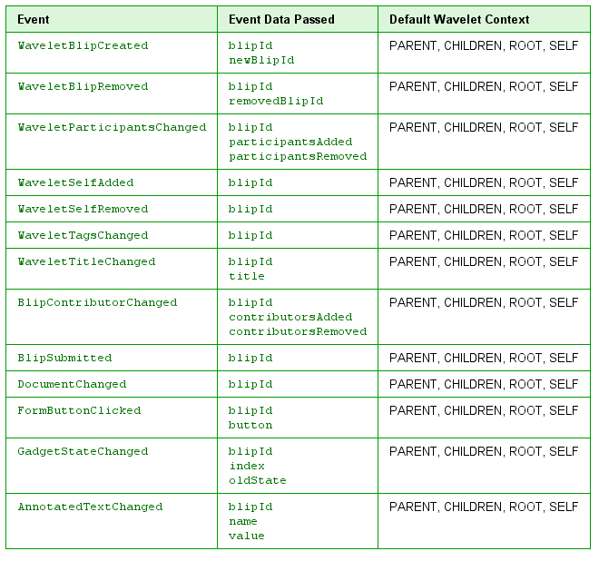
Events
Notes:
17

Slide 4
Exercise
Have your robot say something every time a new blip is created.
Notes:
17

Slide 5
Exercise
Solution: tutorial2
Notes:
17

Slide 6
Operations
It's time to operate

Slide 7
Wavelet Operations
reply()
delete(blipid)
Notes:
17

Slide 8
Blip Operations
Blip Selectors
- all(element|text)
- first()
- at(index)
- range(start, end)
Blip Operations
- insert(element|text)
- insert_after(element|text)
- replace(element|text)
- delete()
- clear_annotation()
- update_element(value)
Notes:
17

Slide 9
Blip Operation Examples
blip.all('hello').replace('good-bye')
Notes:
17

Slide 10
Exercise
Have your robot update all frownies :( in text into smileys :)
What event should it respond to?
Notes:
17

Slide 11
Exercise
Solution: tutorial3
Notes:
17

Slide 12
Annotations
To boldly go where no robot has gone before

Slide 13
Annotations
- Key-value pairs
- Apply to a range
- Expand and contract
Notes:
17

Slide 14
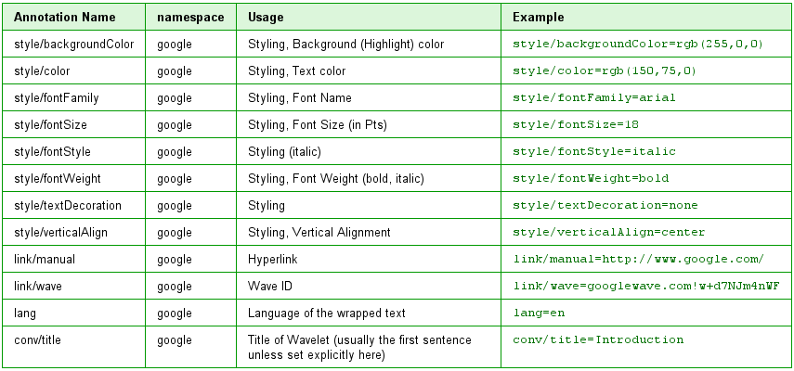
Annotations
Notes:
17

Slide 15
Annotation Bundles
event.blip.all("hello")
.replace("goodbye",
[
('style/color', 'blue')
]
)
Notes:
17

Slide 16
Exercise
Have your robot update all frownies :( in text into bold smileys :)
Notes:
17

Slide 17
Exercise
Solution: tutorial4
Notes:
17

Slide 18
Thank You
Questions?

